Slide 1
Geodemographics Model based on Vienna’s Open Data
María Inés Plaza Schwarck
(Mari Plaza)

Slide 2
Possible Usages for the Model
Business Owners
Marketing Campaigns
Possible Expansions
WKO
Entrepreneur Assistance
Policy Makers
Program Effectiveness and Coverage
Students
Freie Lokal
Research
Population’s requirements

Slide 3
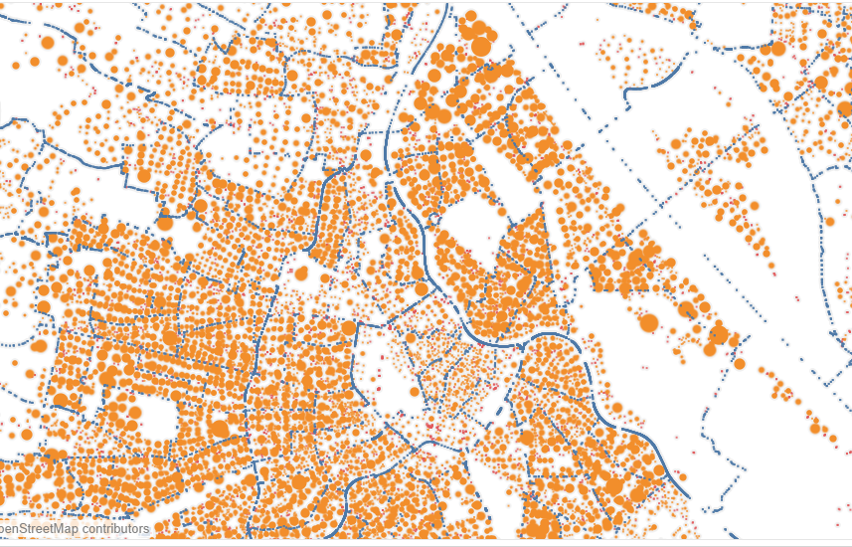
Architecture and Sources for the Model
Geographical Points
(Density holders)
Population’s
Demographics
Vienna’s Population Density
(Residential and Commercial)
By Age Group
By Nationality
By Income
Vie_303.csv
By Gender
Vie_304.csv
Vie_113.csv
Commercial
References
Residential
GENFLWIDMUNGOGD.csv filter by Widmungsklasse.
Steigen.csv (Public Transport Stops)
ZAEHLBEZIRKOGD.csv (Sub district’s borders)
UNIVERSITAETOGD.csv (Universities)
VOLKSHOCHSCHULEOGD.csv (Schools)
BUECHEREIOGD.csv (Libraries)
KINDERGARTENOGD.csv (Kindergartens)
MUSIKSINGSCHULEOGD.csv (Music Schools)
SCHULEOGD.csv (Schools)
Using Sub-District
Using Sub-District and Proportional Area or Capacity

Slide 4
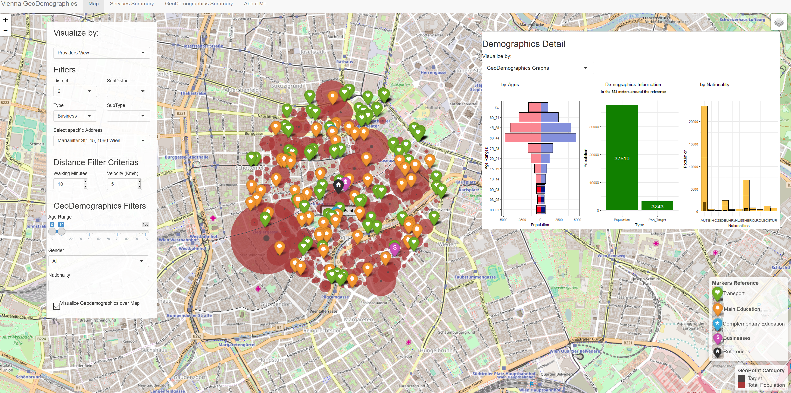

Slide 5
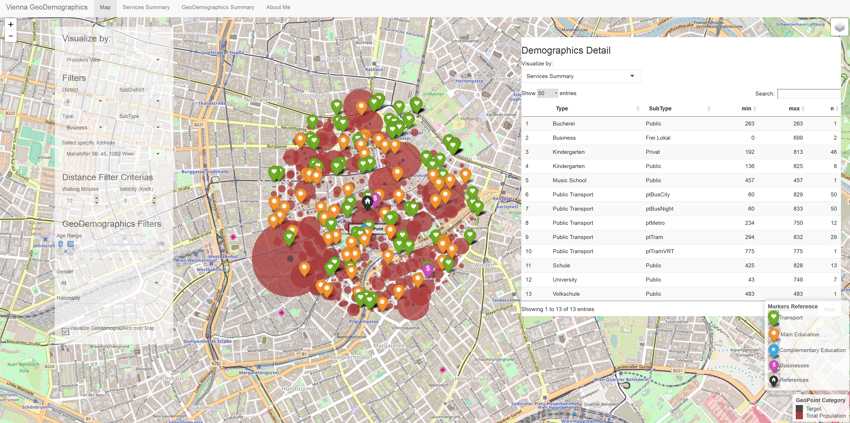

Slide 6
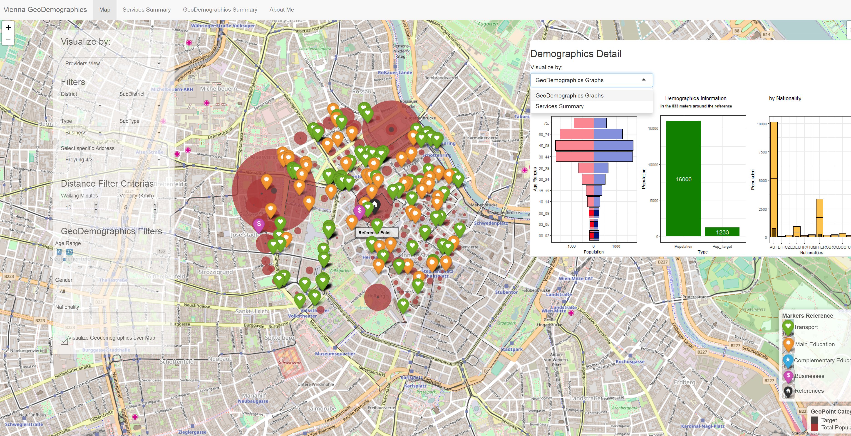

Slide 7
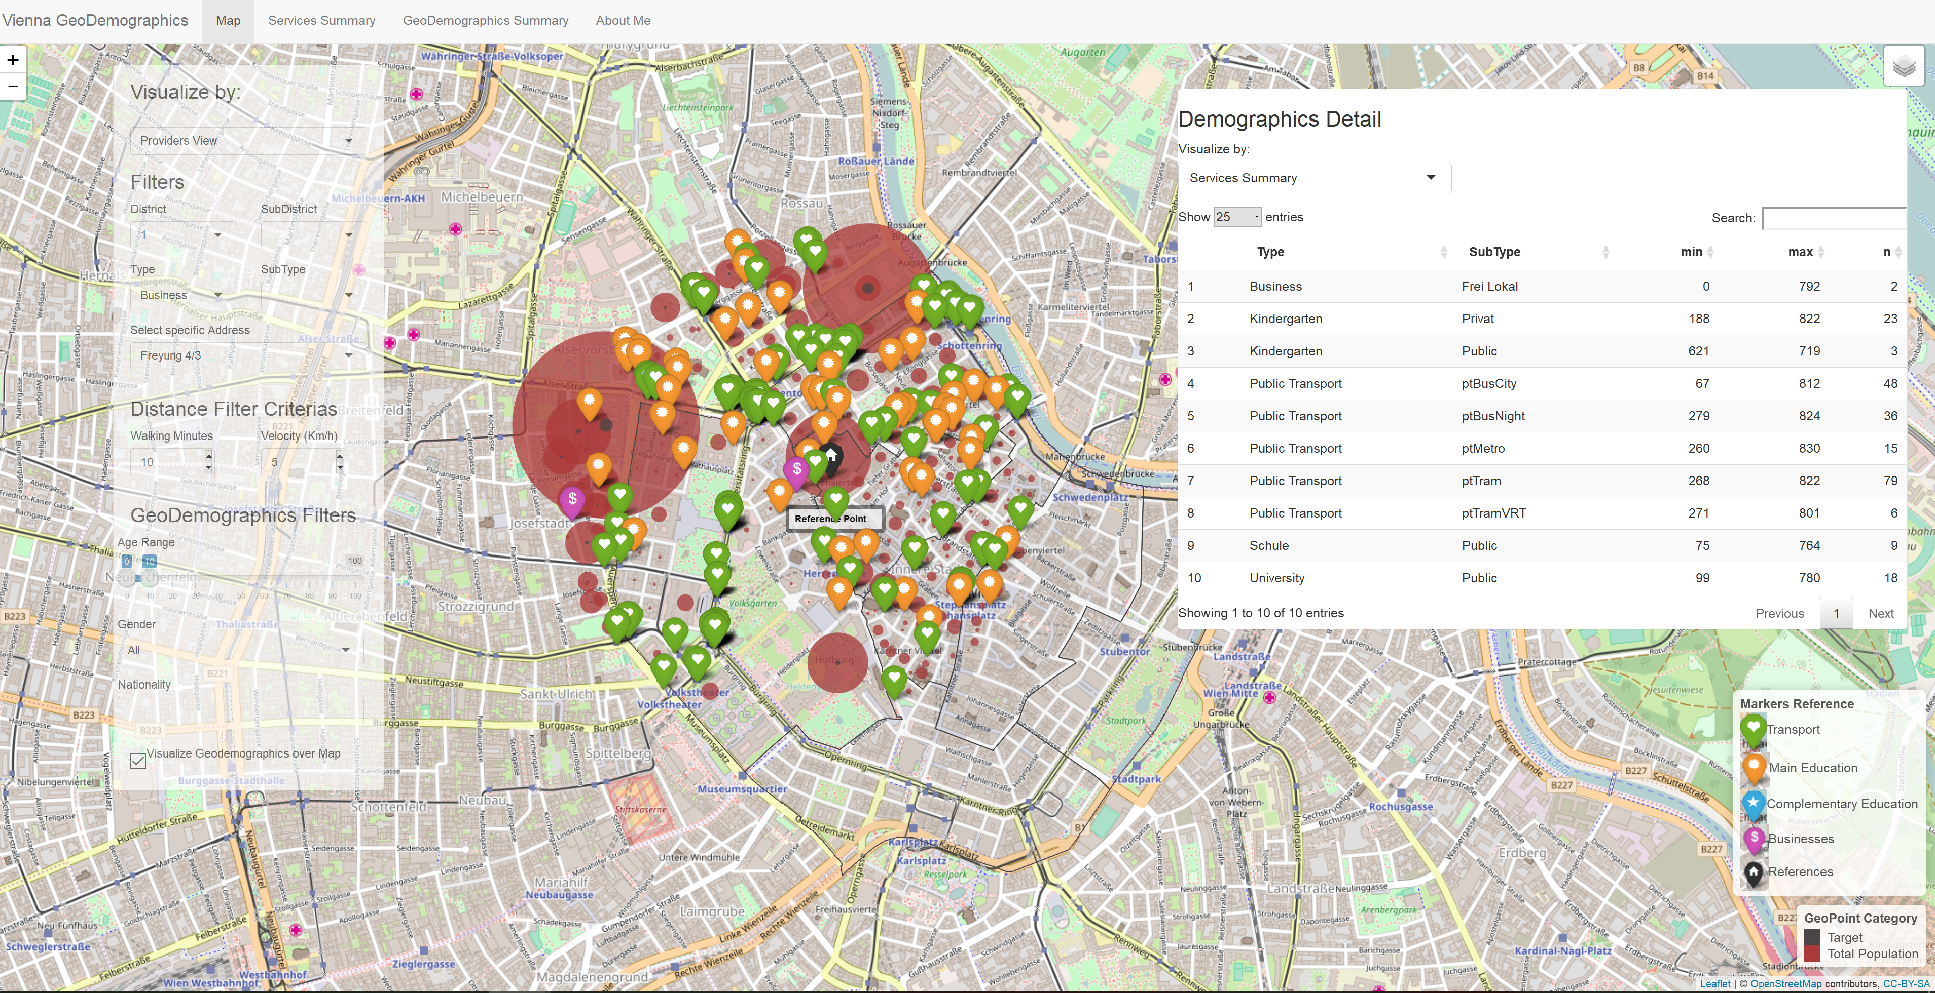

Slide 8
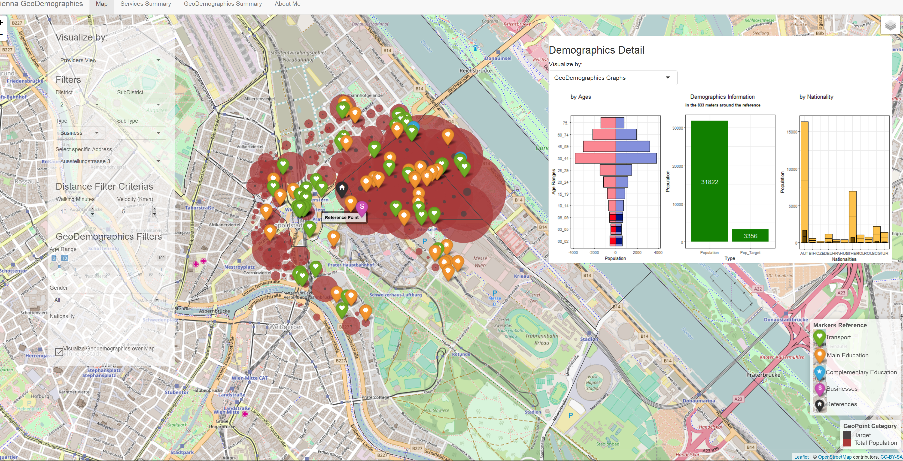

Slide 9
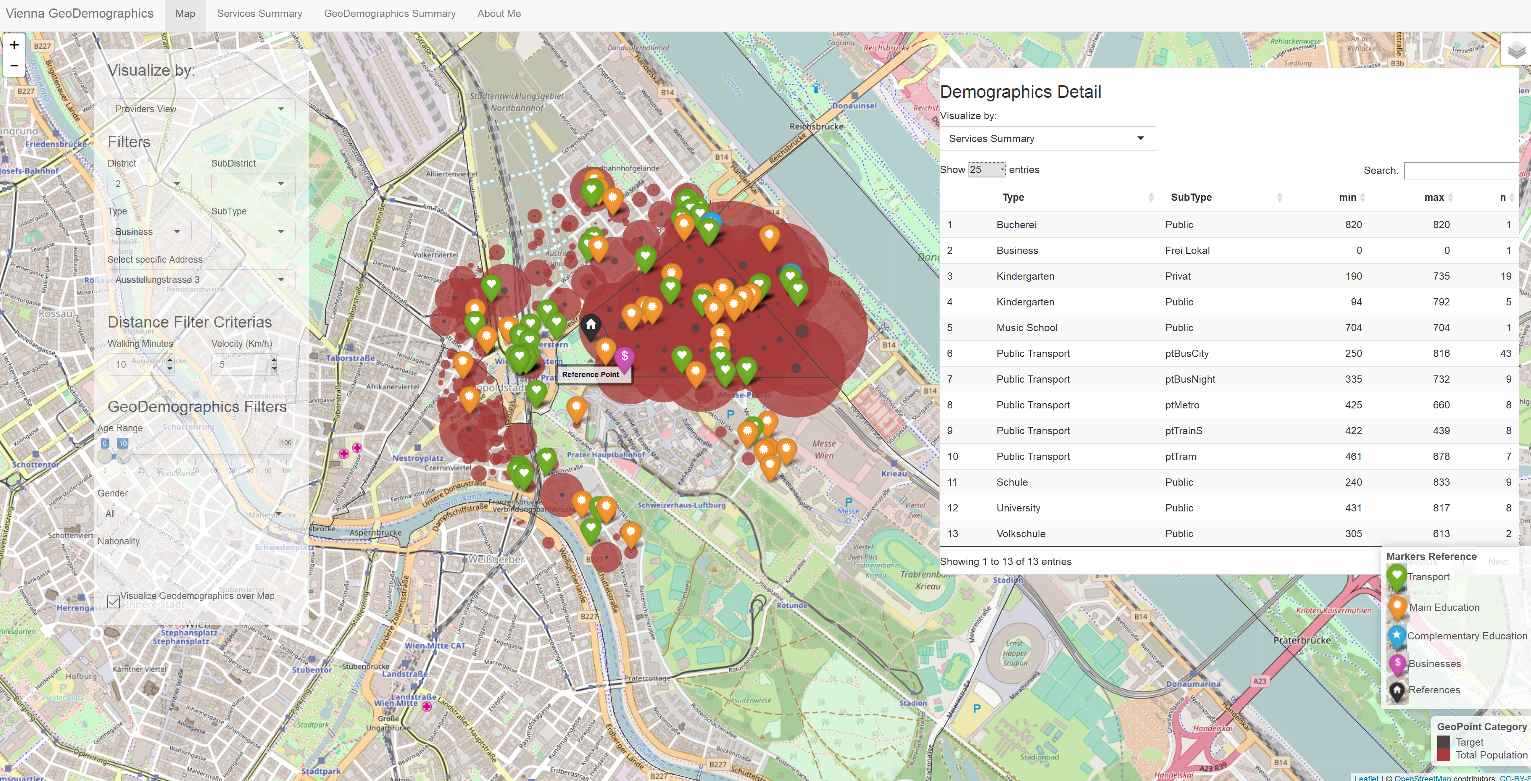

Slide 10
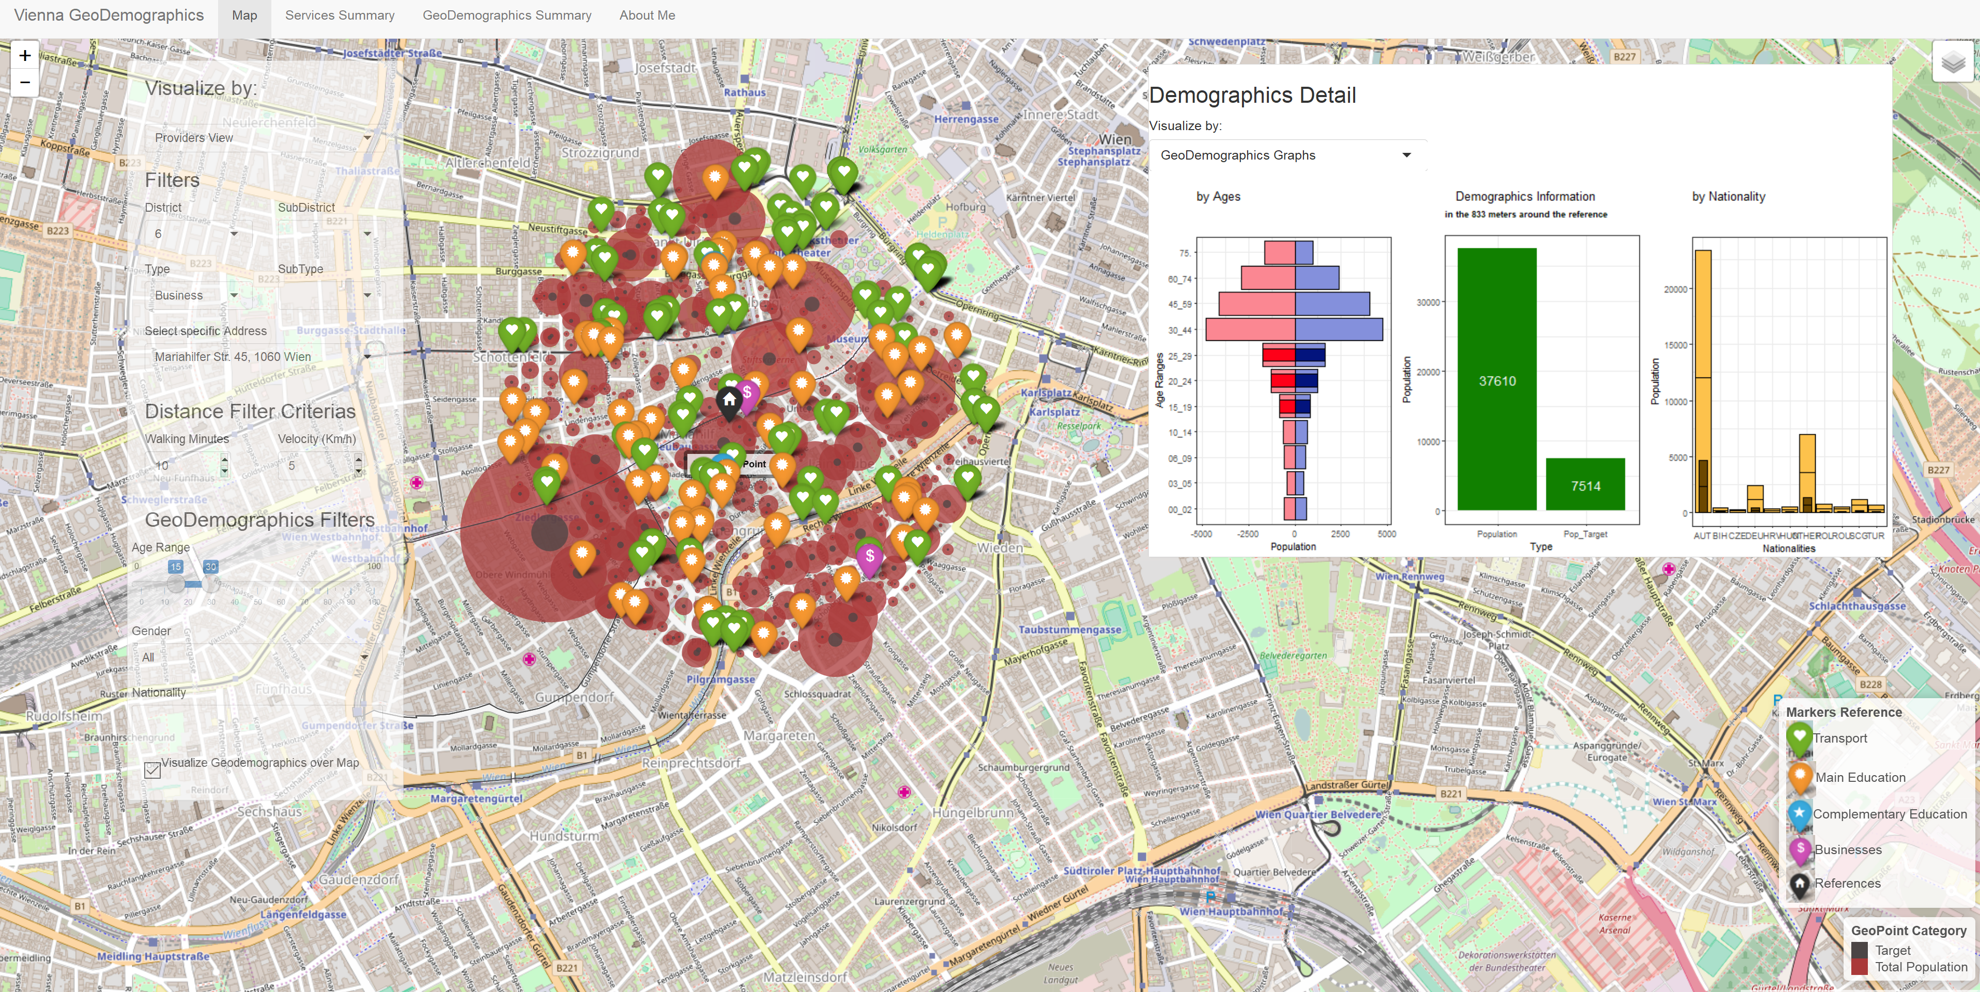

Slide 11

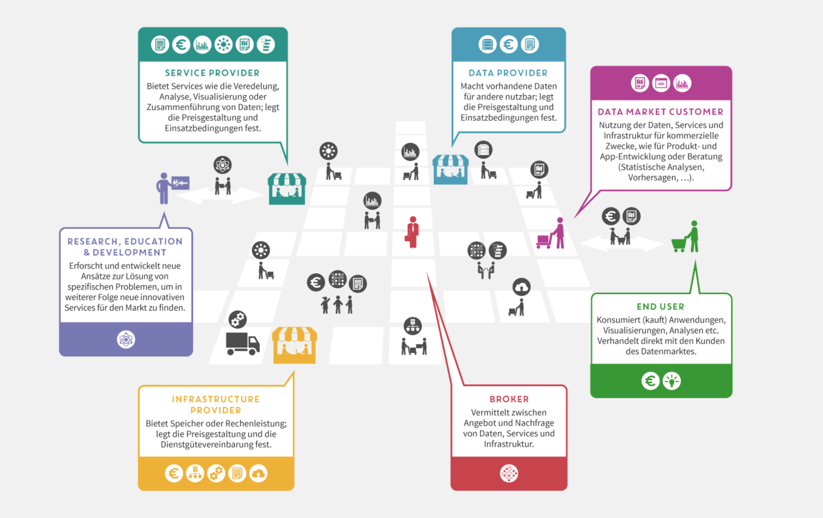
The Model and Data Market Austria
Infrastructure for Production
Potential End Users
Business Owners
Policy Makers
WKO
Students
…….
…….
…….
Mari

Slide 12
Contact Information
Prototype available at:
https://mariplaza.shinyapps.io/GeoDemographics/
LinkedIn: Maria Ines Plaza Schwarck

